Slide 1
Interesting Case
Morbid obesity
R1 สุพฤกษ์ / อ.ณรงค์ศักดิ์

Slide 2
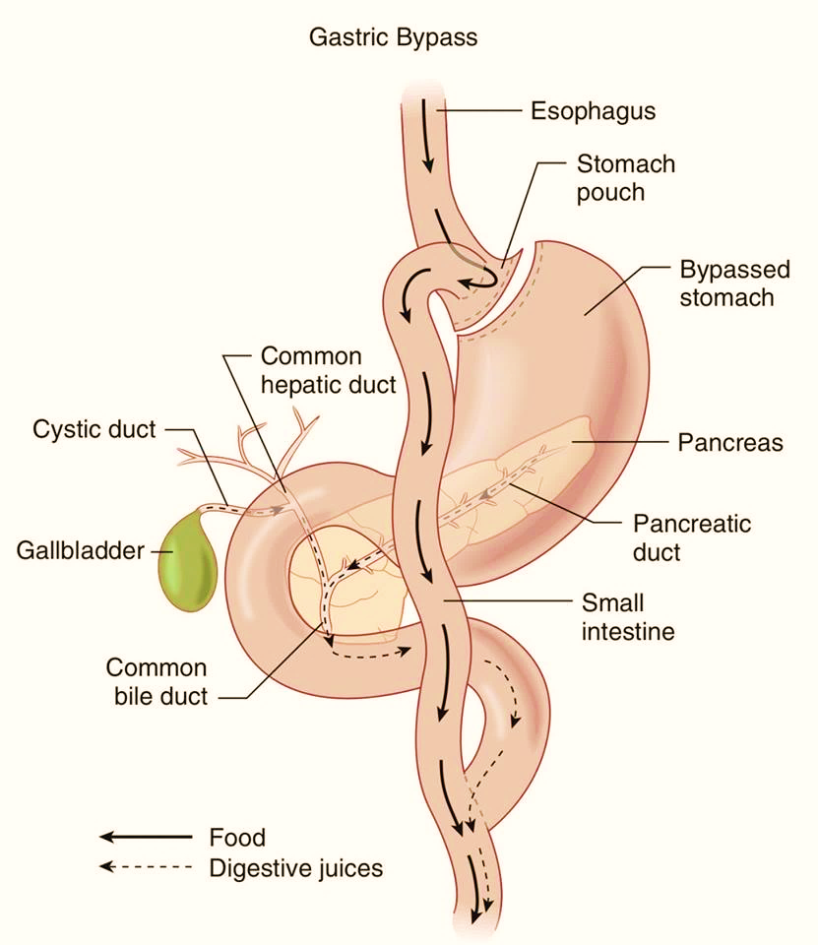
Case ผู้ป่วยชาย อายุ 33 ปี
Diagnosis : Morbid obesity
Operation : Laparoscopic Roux-en-Y gastric bypass

Slide 3
Case
Chief complaint : นัดมาผ่าตัด
Present illness : 4เดือนPTA ผู้ป่วยต้องการลดน้ำหนัก ควบคุมอาหาร + ออกกำลังกายแต่ไม่สามารถลดน้ำหนักได้ จึงมาผ่าตัดลดน้ำหนัก

Slide 4
R1 History

Slide 5
Past history
Underlying disease : HT , T₂DM , OSA

Slide 6
Past history
No drug allergy
No history of surgery
No smoking
No alcohol drinking
No previous anesthesia

Slide 7
Past history
Functional class 1
OSA →On CPAP 7 cmH₂O

Slide 8
Current medication
Metformin (500) 1x1 po pc
Amlodipine (10) 1x1 po pc
Metoprolol (100) 1/2x1 po pc
Losartan (50) 1x1 po pc

Slide 9
R1 Physical examination

Slide 10
Physical examination
Vital signs : BP 128 /80 mmHg PR 60 bpm
BT 36.3 c RR 16 tpm
BW 162 kg, Height 178 cm (BMI 51.1 kg/m²)

Slide 11
Physical examination
Airway : mallampati grade II
thyromental distance >6 cm
mouth opening >3cm
upper lip bite test class I
no limitation of neck motility
dental – normal
Neck circumference 47 cm

Slide 12
Physical examination
Heart : Regular, normal S1 S2, no murmurs
Lungs : Normal breath sounds, no crepitation
Neuro : E₄V₅M₆, no facial palsy, full EOM, Pupil 3 mm RTLBE, sensory intact, motor grade V/V all

Slide 13
R1 Investigation

Slide 14
Investigation
CBC : Hb 14.9g/dl Hct46.8%,
Platelet 293,000/mm3
BUN/Cr :12.9/ 0.76 mg/dL
Electrolyte :
Na 137 mEq/L K 3.8 mEq/L
Cl 100 mEq/L HCO3 22.8 mEq/L
FBS 110 mg/dL

Slide 15
Investigation
EKG 12 leads

Slide 16
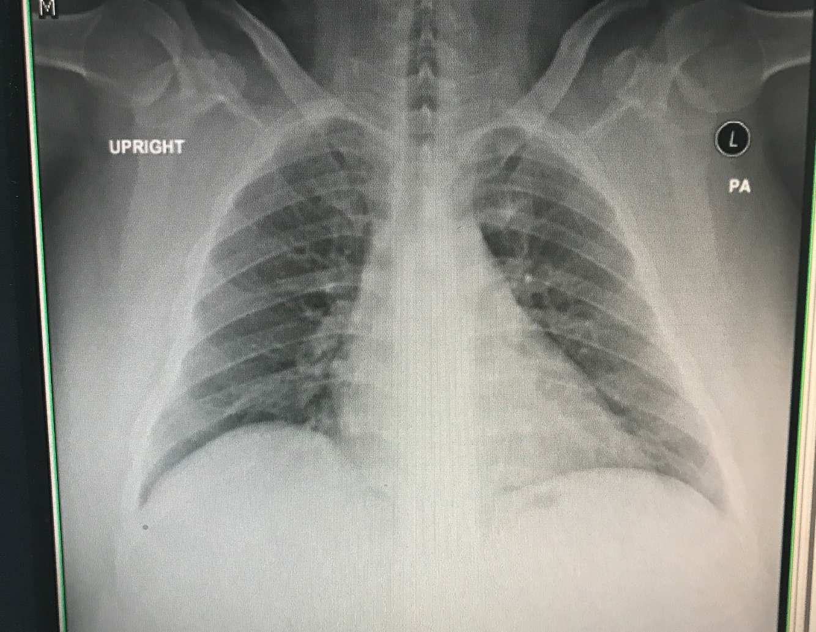
Investigation
CXR

Slide 17
Investigation
Echocardiogram
LVEF 68%
No RWMA
Normal diastolic function
No valvular abnormality

Slide 18
Investigation
Pulmonary function test
Moderate restrictive ventilatory defect
Notes:
Bronchodilator therapy → fail

Slide 19
Investigation
Polysomnography
AHI = 19.5 → Moderate OSA
Notes:
Apnea–Hypopnea Index

Slide 20
R1 Problem lists & ASA clssification

Slide 21
Problem lists
Morbid obesity (Super obese)
HT
DM
OSA

Slide 22
ASA classification
ASA III

Slide 23
R2 preoperative evaluation & prepraration

Slide 24
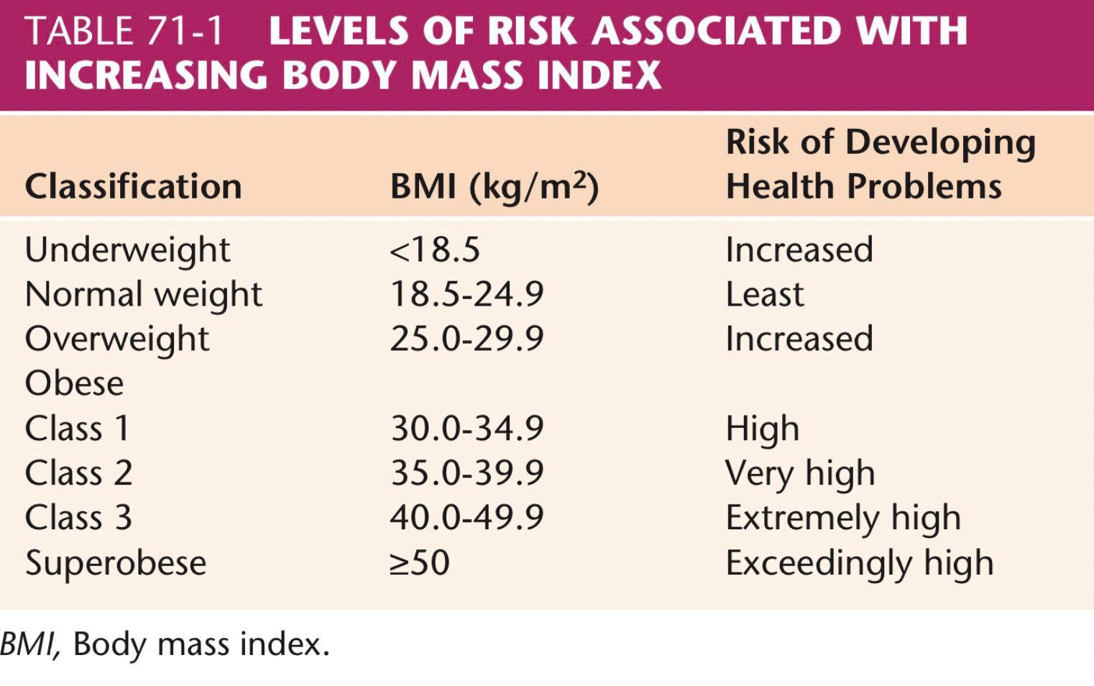
Obesity
Miller’s anesthesia Eighth edition; Ronald D. Miller Anesthesia for Bariatric Surgery,p2201

Slide 25
Surgical management
Malabsorptive procedures
Jejunoileal bypass
Biliopancreatic diversion
Restrictive procedures
Vertical banded gastroplasty
Sleeve gastrectomy
Adjustable gastric banding
Combined procedures
Gastric restriction + minimal degree of malabsorption
Roux en Y gastric bypass (RYGB)

Slide 26
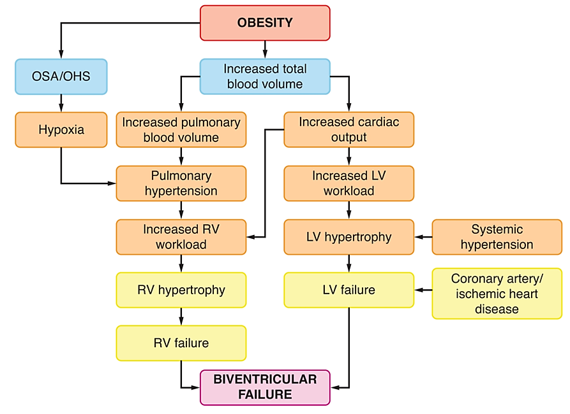
Obesity
Cardiovascular system
Systemic hypertension
Pulmonary hypertension
Heart failure
Ischemic heart disease
Notes:
↑ total blood volume
↑ CO
LVH
Diastolic dysfunction
↑ LVDP
LV failure
Pulmonary edema
Hypoxia ->
↑ Pulmonary HTN
RVH
RV failure

Slide 27
Obesity
Respiratory system
Fat accumulation on the thorax and abdomen decreases chest wall and lung compliance
Decrease FRC
Vital capacity
Total lung capacity
Increase oxygen consumption and carbon dioxide production
Notes:
↓ lung compliance
↓ FRC, ↓ VC, ↓ TLC
↓ FRC -> ↓ ERV
most commonly reported abnormalities of pulmonary function in obese patients
RV ,CC,FEV1 ,FVC unchanged
↓ FRC -> ↓ ERV
ERV is the most sensitive indicator of the effect of obesity on pulmonary function

Slide 28
Obesity
Airway
Excessive tissue folds & fat pads
Short ,thick neck
Difficult mask ventilation
Probability of a problematic intubation
= 5% with 40 cm neck circumference
= 35% with 65 cm neck circumference
Notes:
Excessive tissue folds in mouth and pharynx
Fat pads : submental ,suprasternal ,presternal,posterior cervical fat , large breast

Slide 29
Obesity
Metabolic issues
High prevalence of insulin resistance and diabetes
Glycemic control
Electrolyte

Slide 30
Obesity
Hematologic issues
Risk factor for perioperative thromboembolic events
Thromboprophylaxis

Slide 31
Obesity
Gastrointestinal system
Delayed gastric emptying time
Increase gastric volume & acidity
lower esophageal sphincter relaxation
Aspiration prophylaxis
Notes:
Delayed gastric emptying time : Antral distension, Gastrin release, decrease in pH จากparietal cell secretion
Increase frequency Transient lower esophageal sphincter relaxation: increase intraabdominal pressure → increase intragastric pressure

Slide 32
HT
Identified normal baseline BP
Evaluate end organ damage

Slide 33
DM
Blood glucose preoperative
End organ damage :
Macrovascular : stroke ,MI
Microvascular : nephropathy , neuropathy , cardiomegaly

Slide 34
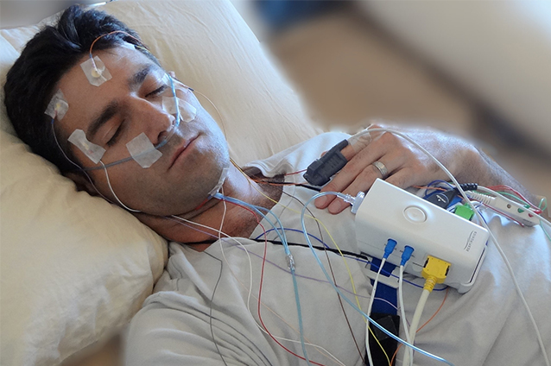
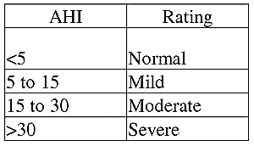
OSA
Polysomnography
AHI = 19.5 → Moderate OSA
Notes:
Miller
AHI มากกว่า30 บ่งบอกว่าsevere sleep apnea และเป็นwarning signของ rapid,severe desaturation during induction
CPAP level ที่มากกว่า10cmH2O potential for difficult ventilation by mask

Slide 35
Preoperative Preparation
Inform consent
NPO
Force air warmer
warm IV fluid
Proper size NIBP cuff
Proper operating table
difficult airway equipment
Post op ICU
Notes:
NPO เหมือนคนทั่วไป
Intubating equipments
Intubating stylets
Videolaryngoscopes
LMA
Fiber‐optic bronchoscopes

Slide 36
Premedication
Amlodipine (10) 1 tab
Metoprolol (100) ½ tab
Enoxaparin 0.4 ml sc
Aspiration prophylaxis

Slide 37
Choice of anesthesia
GA with ETT with RSI with cricoid pressure

Slide 38
Intraoperative management
Monitoring : EKG , NIBP , O₂sat , EtCO₂ , Temp
Position : supine
lab monitoring : blood glucose
Notes:
ต่อไป consideration

Slide 39
R3 anesthetic considerations

Slide 40
Airway Management
Adequate preoxygenation
Rapid oxygen desaturation
Hypoxia and aspiration should be prevented

Slide 41
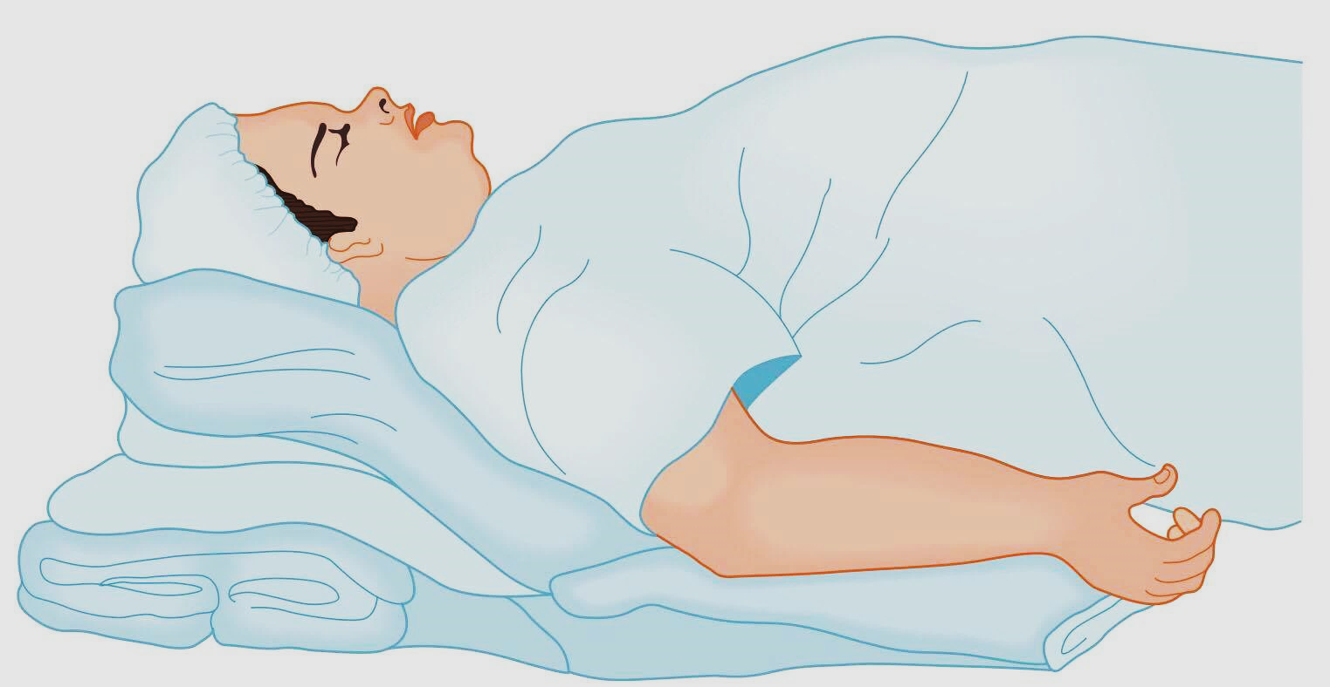
Airway Management
Ramp position

Slide 43
Induction and Maintenance
Rapid sequence induction??
Risk
Difficult mask ventilation
Difficult intubation
Hypoxemia
Gastric aspiration
Notes:
Desflurane : consistent and rapid recovery profile
Remifentanil and fentanyl : avoid postop respiratory depression

Slide 44
Induction and Maintenance
Desflurane
better hemodynamic stability & slightly faster washout
Short acting opioids are prefered in obese patients
Remifentanil and Fentanyl are most common choices
Notes:
Desflurane : consistent and rapid recovery profile
Remifentanil and fentanyl : avoid postop respiratory depression

Slide 45
Induction and Maintenance
Profound muscle relaxation → facilitate ventilation &safe manipulation of laparoscopic instrument
Anesthesia personnel may be ask to facilitate the proper placement of an intragastric balloon
Check ETT

Slide 46
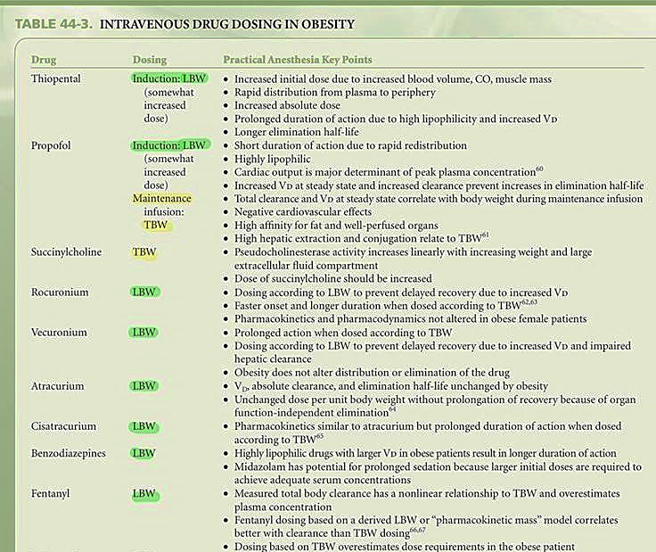

Slide 48
Intravenous drugs
Use TBW
Succinylcholine
Propofol (Maintainance)
Neostigmine
Dexmedetomidine

Slide 49
IBW (kg) = height(cm) – X
X _{male} = 100
X _{female} = 105
LBW = 120% of IBW

Slide 50
Mechanical ventilation
Ventilatory mode
No specific ventilatory mode has been found significantly better oxygenation and CO₂ clearance
Tidal volume
Maintained < 13mL/kg
Higher TV only increases the peak airway pressure,end expiratory airway pressure without improving oxygenation

Slide 51
Laparoscopy
CVS
SVR ,MAP
Venous return
Pneumoperitoneum should not >15 mmHg
RS
Lung volume ,lung compliance
Inspiratory pressure
Cephalad displacement of carina

Slide 52
Emergence
Neuromuscular blockade must be fully reversed before extubation
Awake extubation
CPAP can be deliverd immediately

Slide 53
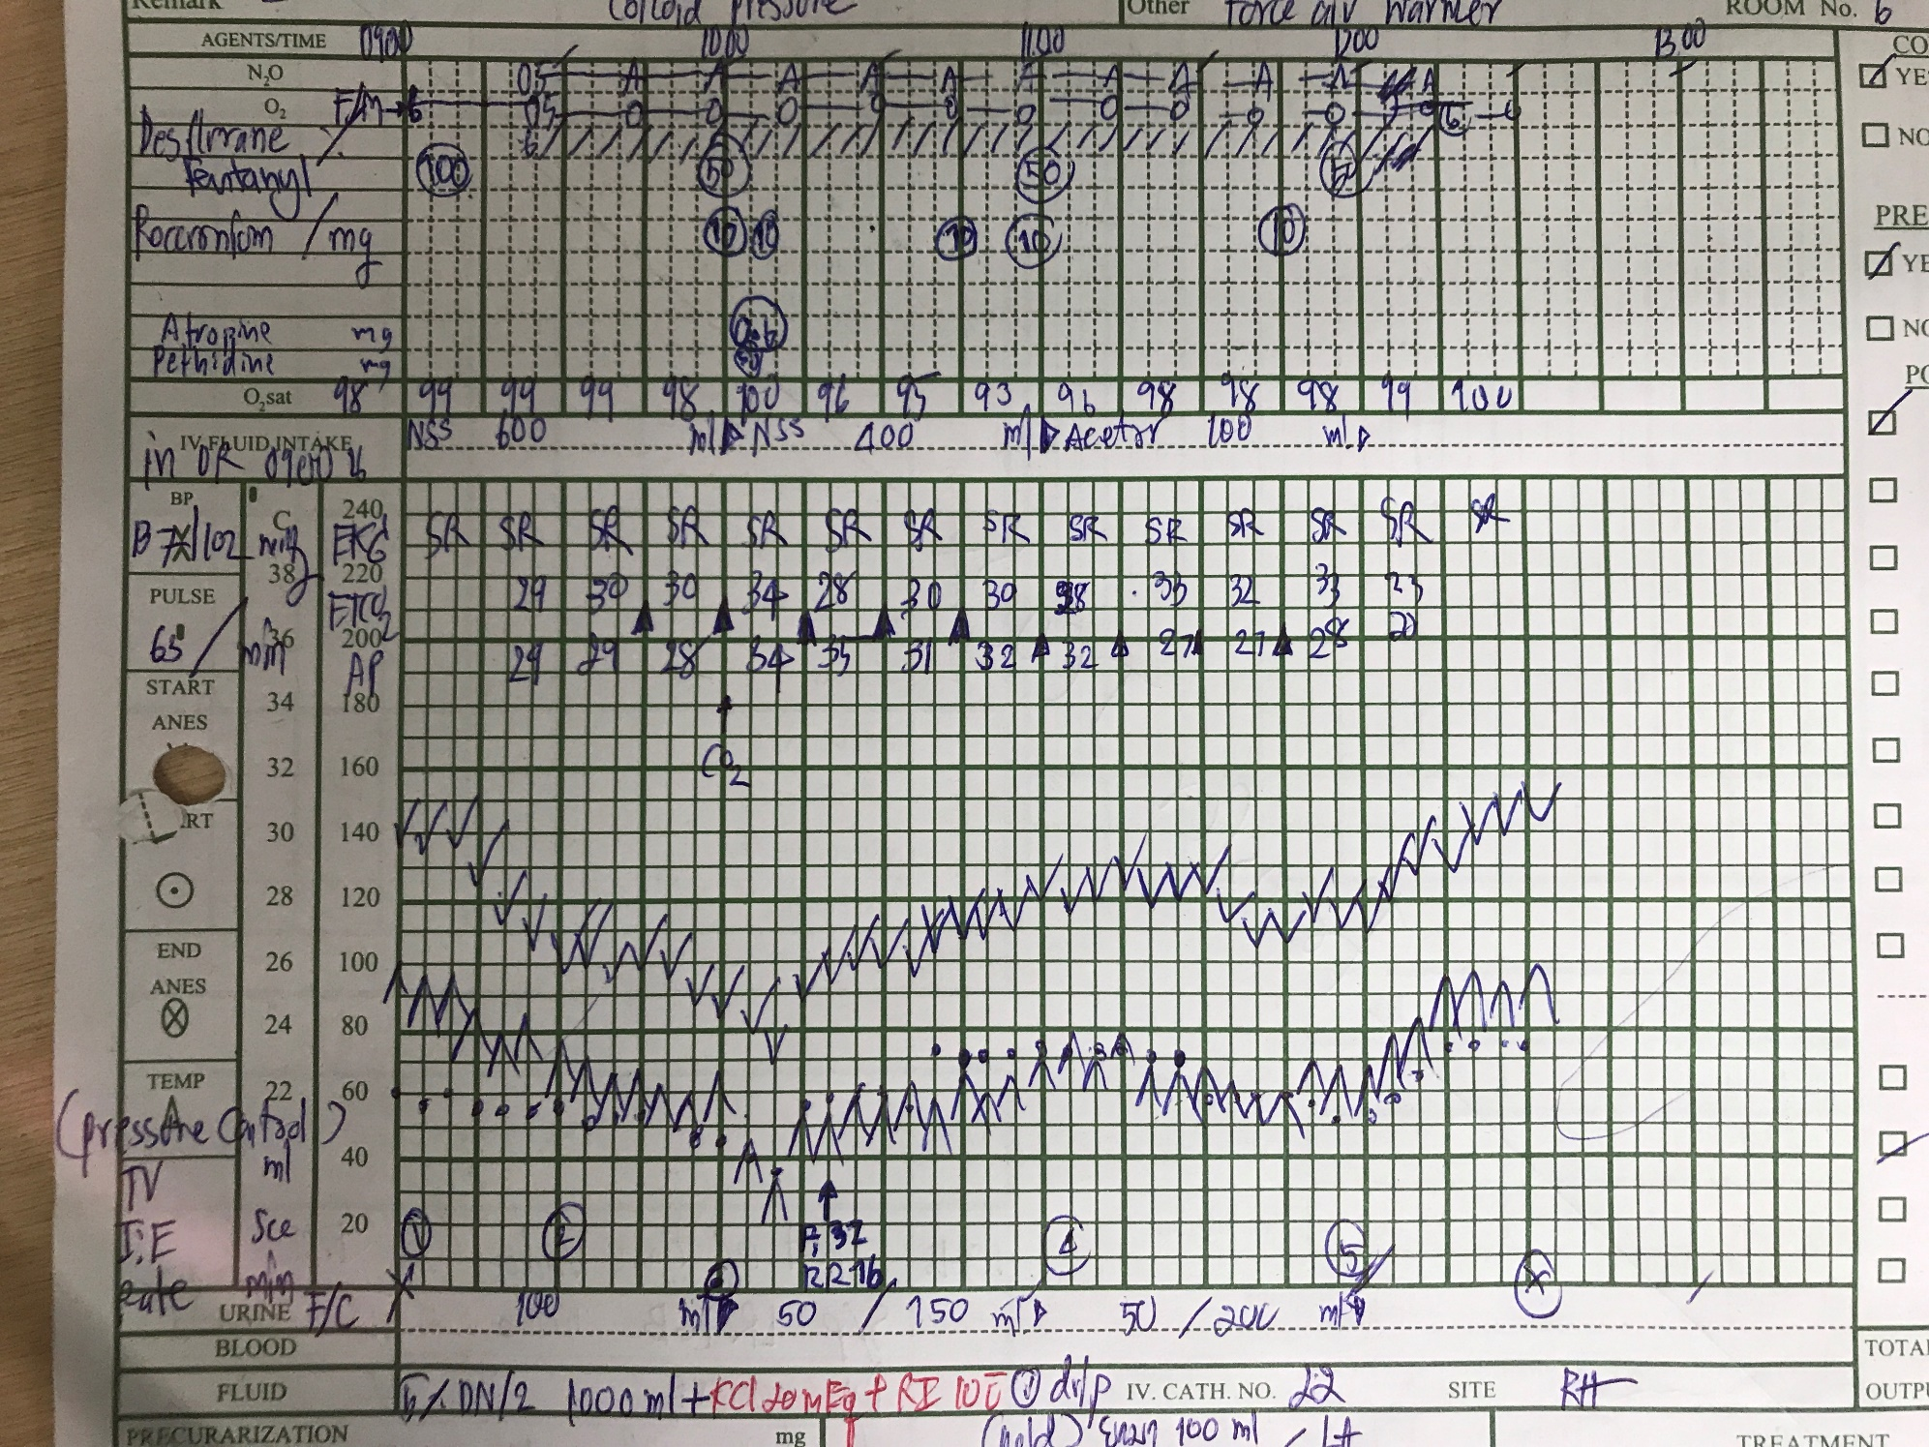
BP at OR 137/102 PR 65
preoxygenation

Slide 54
Induction & intubation:
Fentanyl 100 mcg
Propofol 200mg
Rocuronium 70 mg
ETT no 8 depth 22 cm

Slide 55
CO₂ insufflation
Bradycardia HR 40 bpm
BP 80/40 mmHg

Slide 56
Maintainance: Air:O₂:0.5:0.5 Desflurane6%
Muscle relaxant: Rocuronium 50 mg
Analgesia : Fentanyl 200 mcg
Reverse : Neostigmine 5 mg +Atropine 1.2mg
Antiemitic : onsia 8 mg IV,Dexamethasone 8 mg
IV fluid : NSS 1000 ml + Acetar 250 ml
Urine output : 200 ml
EBL : minimal
Operation time : 3 Hr 30 min

Slide 57
Post-operative
S : ตื่นดี หายใจปกติ ไม่ปวดแผล ไม่มี N/V
O : BP 132/70 mmHg PR 93 BPM BT 37.4°C RR 16 breaths /min
A + P
S/P Laparoscopic Roux-en-Y gastric bypass
NPO
On O₂ mask with bag
Pain control : MO 30 mg + NSS 100 ml IV 3 ml/hr
Notes:
Ventilation management
initiation CPAP

Slide 58
Thank you

